Slide 1
HARDWARE

Slide 2
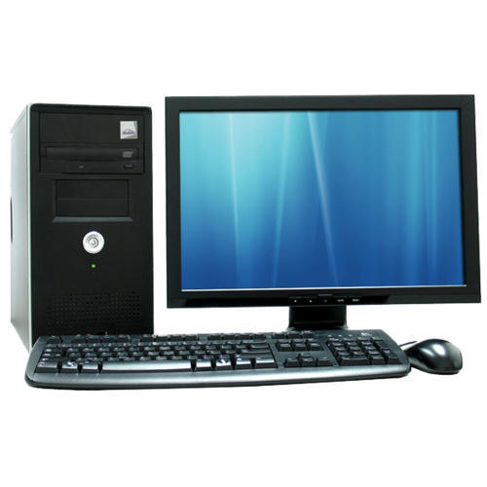
COMPUTER
A computer is a device that can be instructed to carry out arbitrary sequences of arithmetic or logical operations automatically.
What is Computer Software?
What is Computer Hardware?

Slide 3
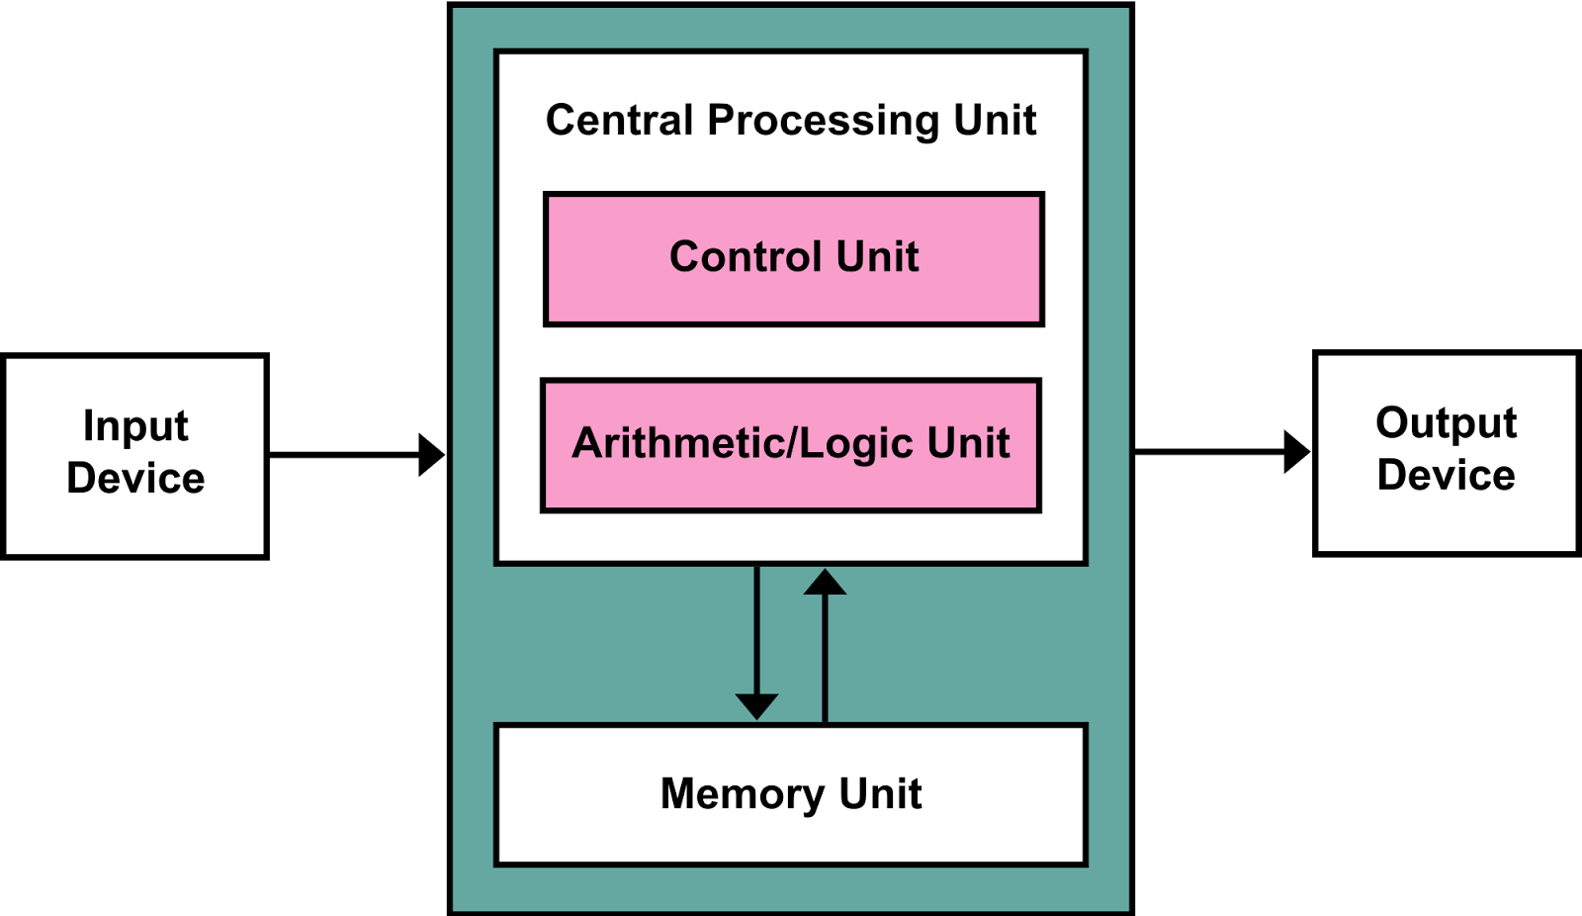
Block Diagram of a Computer

Slide 4
What is a keyboard?
A computer keyboard is one of the primary input devices used with a computer that looks similar to those found on electric typewriters, but with some additional keys. Keyboards allow you to input letters, numbers, and other symbols into a computer that can serve as commands or be used to type text.
Keyboards are of two sizes 84 keys or 101/102 keys, but now keyboards with 104 keys or 108 keys are also available for Windows and Internet.

Slide 5
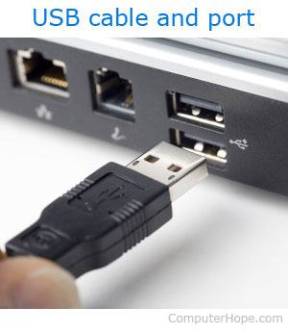
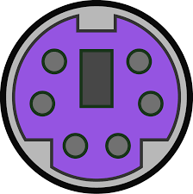
Keyboard ports and interfaces
Today, most desktop computer keyboards connect to the computer using either USB or Bluetooth for wireless communication. Before USB, a computer may have used PS/2, Serial, or AT (Din5) as a keyboard interface.

Slide 6
Mechanical keyboard
Each key on a mechanical-switch keyboard contains a complete switch underneath.
Mechanical keyboards allow for the removal and replacement of keycaps.
Mechanical keyboards also have a longer lifespan than membrane or dome-switch keyboards, with an expected lifespan of 50 million clicks per switch.

Slide 7
Membrane keyboard
A membrane keyboard is a computer keyboard whose "keys" are not separate, moving parts, as with the majority of other keyboards, but rather are pressure pads that have only outlines and symbols printed on a flat, flexible surface.
Membrane keyboards work by electrical contact between the keyboard surface and the underlying circuits when keytop areas are pressed.

Slide 8
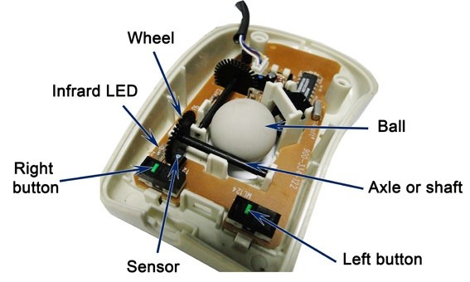
What is mouse?
A computer mouse is a handheld hardware input device that controls a cursor in a GUI and can move and select text, icons, files, and folders.
X-axis wheel turns when you move mouse left and right.
Y-axis wheel turns when you move mouse up and down.

Slide 9
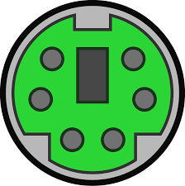
Mouse ports
A dedicated socket in the computer for a mouse. On the first desktop PCs, the mouse connected via the serial port, which was superseded by the PS/2 port. Today, mice plug into any USB port, although motherboards with PS/2 sockets are still made.

Slide 10
Types of mouse
Mechanical mouse: Houses a hard rubber ball that rolls as the mouse is moved.
Optical mouse: Uses an LED sensor to detect tabletop movement and then sends off that information to the computer.
Trackball mouse: Like an upside-down mouse. Rather than roll the mouse around, you use your thumb or index finger to roll a ball on top of the mouse.

Slide 11
SCANNER
Scanner is an electronic device which can capture images from physical items and convert them into digital formats, which in turn can be stored in a computer, and viewed or modified using software applications.

Slide 12
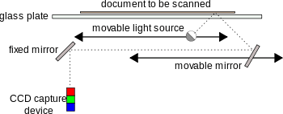
Working principle of Flatbed Scanner

Slide 13
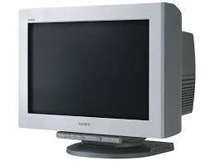
COMPUTER MONITORS
A Computer Monitor is an output device which displays information in pictorial form.

Slide 14
Technologies
Multiple technologies have been used for computer monitors. Those are
Cathode ray tube(CRTs) : The first computer monitors used CRTs in 1970s.
Liquid crystal display(LCD) : Throughout the 1990s, the primary use of LCD technology as computer monitors was in laptops where the lower power consumption, lighter weight and smaller physical size of LCD’s justified the higher price versus a CRT.
Example : TFT- LCD
Organic light-emitting diode(OLED) : Monitors provide higher contrast and better viewing angles than LCDs but they require more power when displaying documents with white or bright backgrounds.

Slide 15
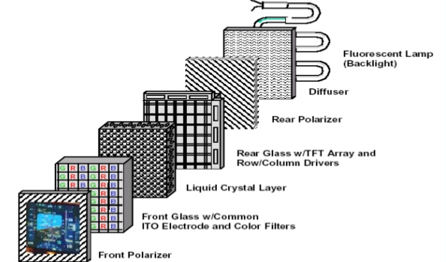
Working principle
LCD (Liquid Crystal Display):
LCD technology is used for displaying the image in notebook or some other electronic devices like mini computers.

Slide 16
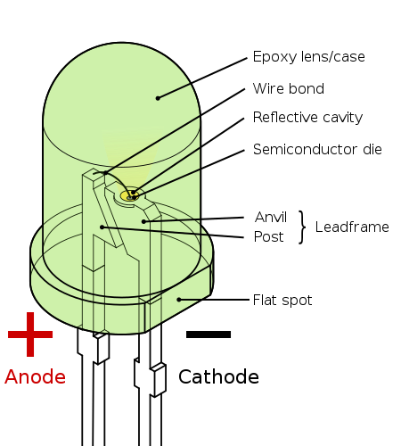
Light-Emitting Diode (LED)
A light-emitting diode (LED) is a semiconductor device that emits visible light when an electric current passes through it.

Slide 17
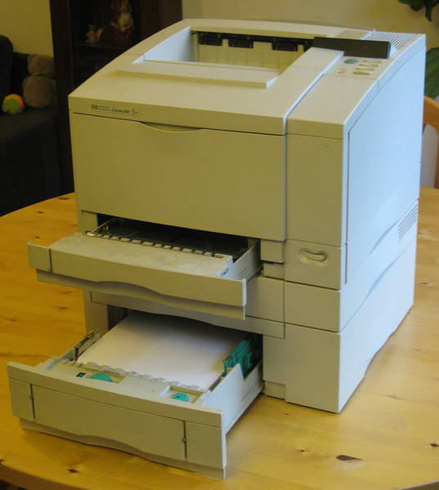
PRINTERS
A printer is a device that accepts text and graphic output from a computer and transfers the information to paper, usually to standard size sheets of paper.

Slide 18
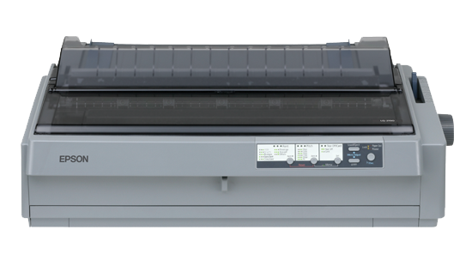
Types of printers
Impact printers: An impact printer makes contact with the paper. It usually forms the print image by pressing an inked ribbon against the paper using a hammer or pins.
Non- impact printers: Non-impact printers do not use a striking device to produce characters on the paper; and because these printers do not hammer against the paper they are much quieter.

Slide 19
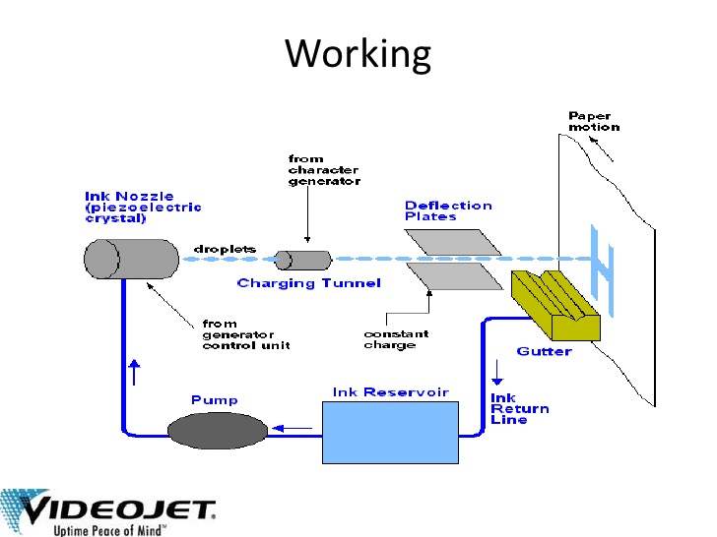
Working principle
Ink-jet printers

Slide 20
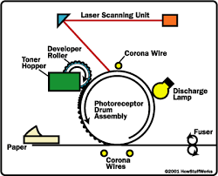
Laser printer:

Slide 21
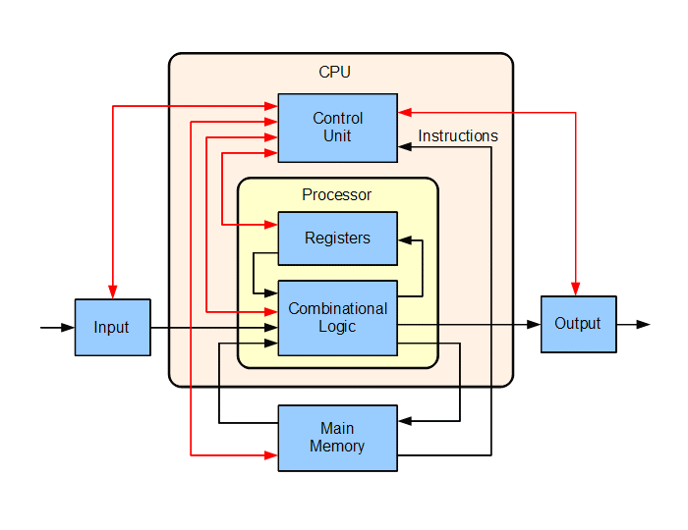
CPU(Central Processing Unit)
It is the heart of the Computer.
It is a electrical circuit that carries out the instruction’s given to it by computer program.
It refers to a Processor.

Slide 22
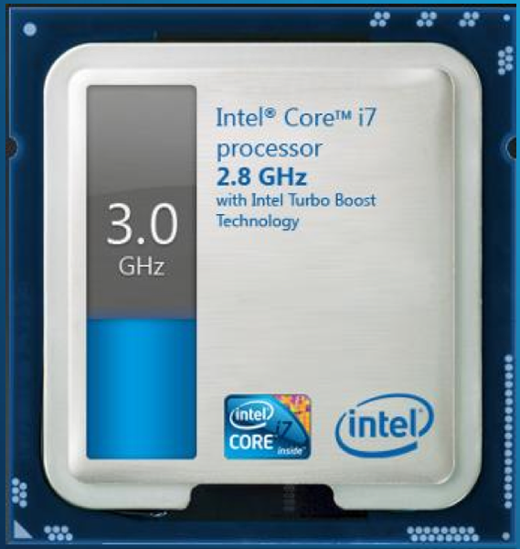
Clock Speed
Clock speed, clock rate or processor speed is a term that is used to determine how fast the processor will execute the given instructions.
It is measured the MHz or in GHz.
The higher the CPU speed, the better a computer will perform.

Slide 23
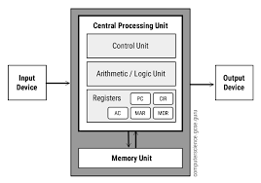
Accumulator.
An accumulator is a register in which intermediate arithmetic and logic results are stored.
It is fast to access the accumulator than to access Main Memory.

Slide 24
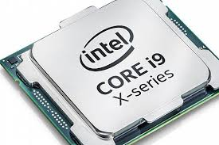
PROCESSOR
A processor is an integrated electronic circuit that performs the calculations that run a computer. A processor performs arithmetical, logical, input/output (I/O) and other basic instructions that are passed from an operating system (OS). Most other processes are dependent on the operations of a processor.

Slide 25
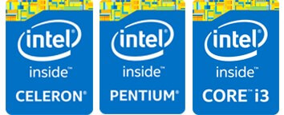

DIFFERENT PROCESSOR FAMILY
Intel
Celeron
Pentium
Core
Advanced Micro Devices (AMD)
Sempron
Athlon
Phenom

Slide 26
TYPES OF CORES
Dual Core Processors
Quad Core Processors
Hexa Core Processors
Octa Core Processors
Deca Core Processors

Slide 27
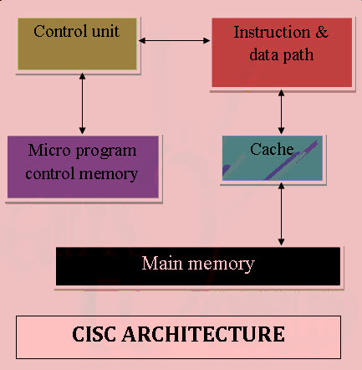
ARCHITECTURE TYPES
CISC Architecture:
The CISC approach attempts to minimize the number of instructions per program, sacrificing the number of cycles per instruction.

Slide 28
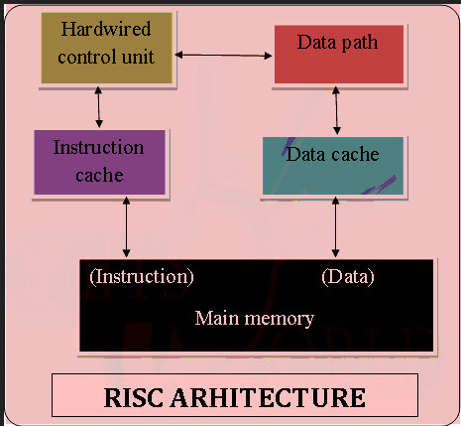
RISC Architecture:
RISC is a type of microprocessor architecture that uses highly-optimized set of instructions. RISC does the opposite, reducing the cycles per instruction at the cost of the number of instructions per program.

Slide 29
OPERATION
Fetch:
The next instruction is fetched from the memory address that is currently stored in the program counter and stored into the instruction register. At the end of the fetch operation, the PC points to the next instruction that will be read at the next cycle.
The fetch step is the same for each instruction:
The CPU sends the PC to the MAR and sends a read command on the address bus
In response to the read command (with address equal to PC), the memory returns the data stored at the memory location indicated by PC on the data bus

Slide 30
The CPU copies the data from the data bus into its MDR (also known as MBR, see section Components above)
A fraction of a second later, the CPU copies the data from the MDR to the instruction register
The PC is incremented so that it points to the following instruction in memory. This step prepares the CPU for the next cycle.
The control unit fetches the instruction's address from the memory unit.
Decode:
During this cycle the encoded instruction present in the instruction register is interpreted by the decoder.

Slide 31
Execute:
The function of the instruction is performed. If the instruction involves arithmetic or logic, the ALU is utilized. This is the only stage of the instruction cycle that is useful from the perspective of the end user. Everything else is overhead required to make the execute step happen.

Slide 32
Parallelism.
Parallel computing is a type of computation in which many calculations or the execution of processes are carried out simultaneously. Large problems can often be divided into smaller ones, which can then be solved at the same time.
There are 5 types of Parallelism they are,
Multi Programming.
Multi Processing.
Multi Tasking.
Multi Threading.
Hyper Threading.

Slide 33
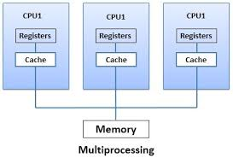
MULTIPROCESSING
Multiprocessing is the use of two or more central processing units (CPUs) within a single computer system.
Ability of a system to support more than one processor or the ability to allocate tasks between them.

Slide 34
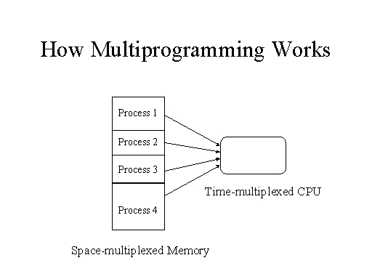
MULTIPROGRAMMING
Multiprogramming means parallel processing in which several programs are run at the same time on a uniprocessor.

Slide 35
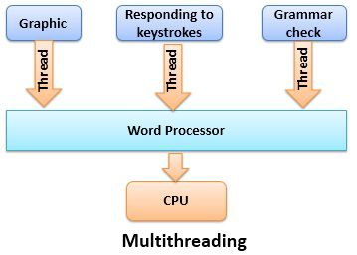
MULTITHREADING
In computer architecture, multithreading is the ability of a CPU to execute multiple processes or threads concurrently, appropriately supported by the operating system.

Slide 36

MULTITASKING
Multitasking, in an operating system, is allowing a user to perform more than one computer task (such as the operation of an application program) at a time.
When you open your Web browser and then open Word at the same time, you are causing the operating system to do multitasking.

Slide 37
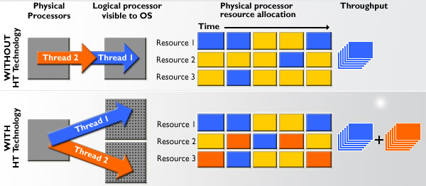
HYPER-THREADING
Hyper-Threading is a technology used by some Intel microprocessor.
It is a technology where the processor is logically divided into two cores for the execution of the programs .

Slide 38
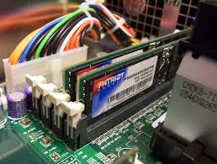
RAM(RANDOM ACCESS MEMORY)

Slide 39
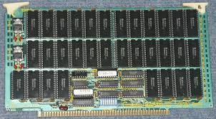
TYPES OF RAM
Static RAM: SRAM is random access memory that retains data bits in its memory as long as power is being supplied.

Slide 40
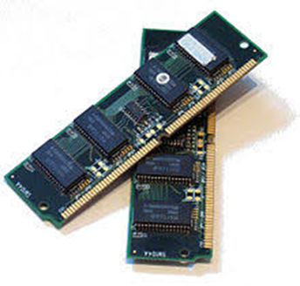
Dynamic RAM: Dynamic random-access memory is a type of random access semiconductor memory that stores each bit of data in a separate tiny capacitor within an integrated circuit.

Slide 41
TYPES OF DYANMIC RAM
SDRAM
DDR SDRAM
DDR2 SDRAM
DDR3 SDRAM
DDR4 SDRAM

Slide 42
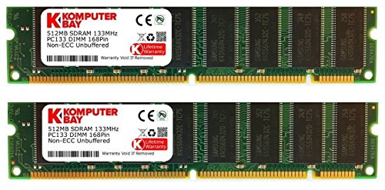
SDRAM
It stands for Synchronous Dynamic Random Access Memory.
SDRAM is designed to synchronize itself with the timing of the CPU.

Slide 43
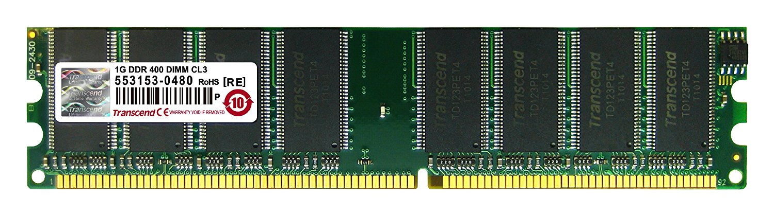
DDR SDRAM
The next generation of SDRAM is DDR, which achieves greater bandwidth than the preceding single data rate SDRAM by transferring data on the rising and falling edges of the clock signal.

Slide 44
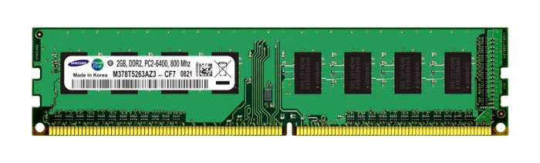
DDR2 SDRAM
Its primary benefit is the ability to operate the external data bus twice as fast as DDR SDRAM. This is achieved by improved bus signal.

Slide 45
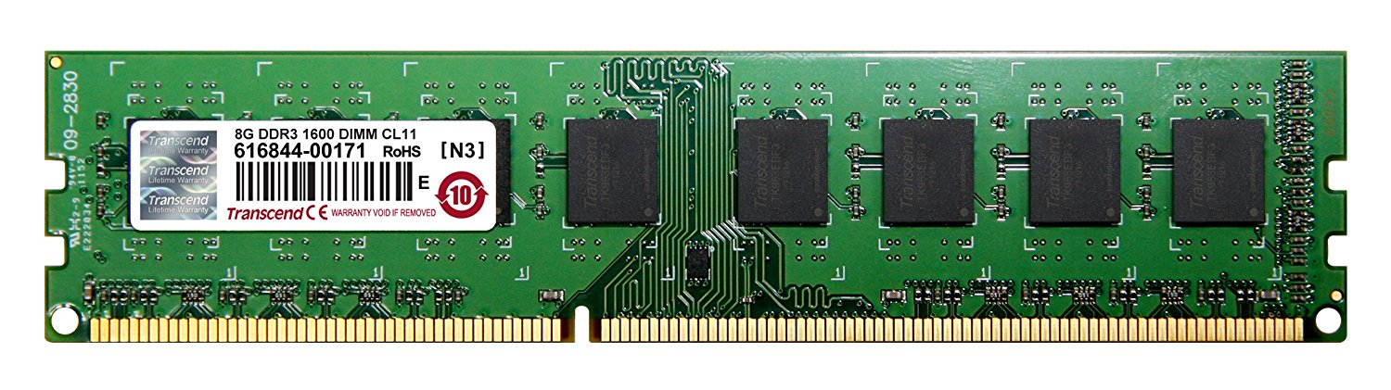
DDR3 SDRAM
DDR3 memory reduces 40% power consumption compared to current DDR2 modules, allowing for lower operating currents and voltages.

Slide 46
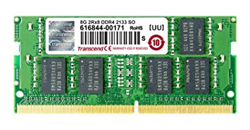
DDR4 SDRAM
DDR4 SDRAM provides the lower operating voltage (1.2V) and higher transfer rate.

Slide 47
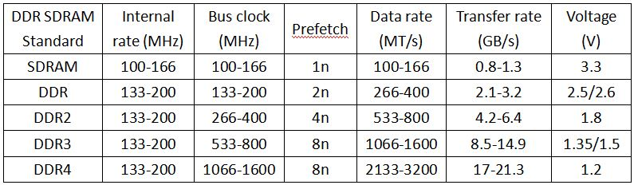
DIFFERENCE BETWEEN SDRAM, DDR, DDR2, DDR3, DDR4

Slide 48
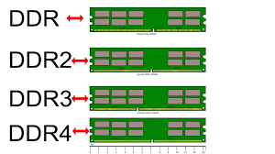
DIFFERENCE BETWEEN DDR, DDR2, DDR3, DDR4

Slide 49
TYPES OF RAM SLOTS
SIMM slot :
SIMM RAM had to be installed at an angle and pushed upright into place.
DIMM slot :
DIMM slots allow for straight-forward installation of memory modules.
RIMM slot :
The module slots for RIMMs were physically similar to DIMM slots and the modules were installed in the same way.

Slide 50
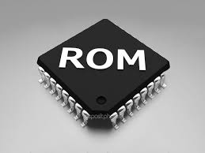
ROM(READ ONLY MEMORY)

Slide 51
TYPES OF ROM
Masked ROM
PROM
EPROM
EEPROM
Flash ROM

Slide 52
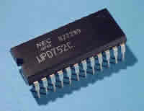
Masked ROM
It is also known as MROM. It is a static ROM which comes programmed into an integrated circuit by its manufacturer.

Slide 53
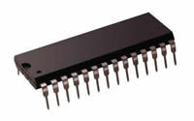
PROM
It stands for Programmable Read Only Memory.
The data stored in it cannot be modified and therefore it is also known as one time programmable device.

Slide 54
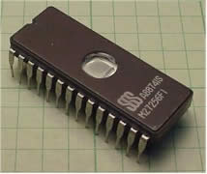
EPROM
It stands for Erasable Programmable ROM. It is different from PROM as unlike PROM the program can be written on it more than once.

Slide 55
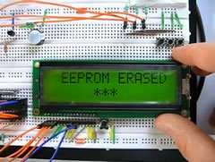
EEPROM
It stands for Electrically Erasable Read Only Memory.
These are also erasable like EPROM, but the same work of erasing is performed with electric current.

Slide 56
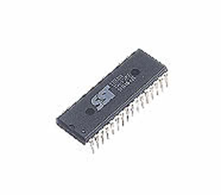
Flash ROM
It is an updated version of EEPROM.
Flash memory provides this advantage over the EEPROM by enabling this feature of altering many locations simultaneously.

Slide 57
CACHE MEMORY
Cache memory or memory cache is afast and relatively small memory, that stores the most recently used main memory data.
It is of 3 types:
L1 cache
L2 cache

Slide 58
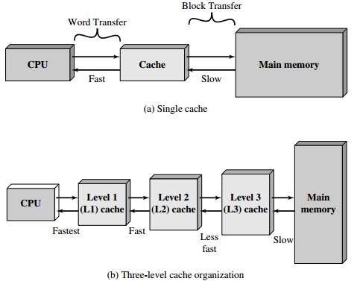
Cache Memory

Slide 59
FIRMWARE
Firmware is a software program permanently etched into a hardware device such as a keyboards, hard drive, BIOS, or video cards. It is programmed to give permanent instructions to communicate with other devices and perform functions like basic input/output tasks

Slide 60
MOTHERBOARD

Slide 61
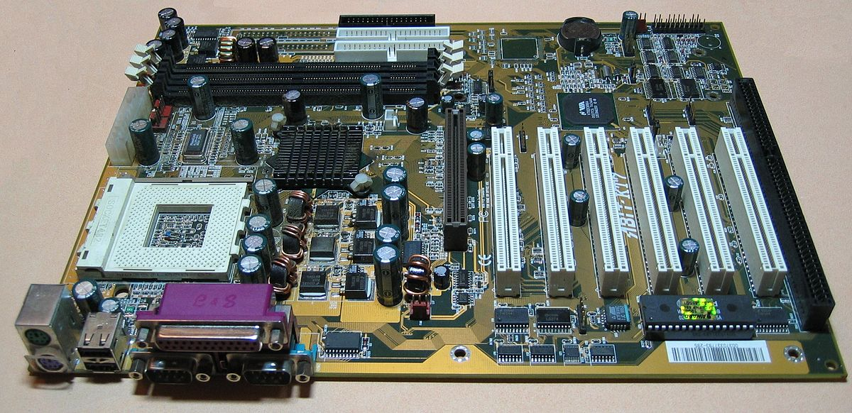

Slide 62
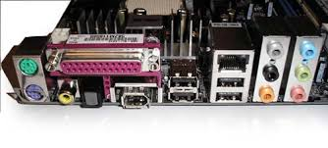
Input/Output Ports
Generally, input and output ports are placed at the very side (back) of computer chassis. In particular, the I/O ports is built to connect the monitor, speakers, a microphone, an Ethernet networking cable and multiple USB devices.

Slide 63
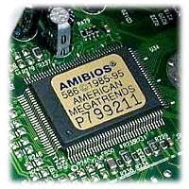
BIOS
BIOS is the short form of “Basic Input Output System.” BIOS is the components of Motherboard, and it is positioned as the Integrated Chip.

Slide 64
POST
A power-on self-test (POST) is a process performed by firmware or software routines immediately after a computer or other digital electronic device is powered on.
Bootstrap loader
Alternatively referred to as bootstrapping, bootloader, or boot program, a bootstrap loader is a program that resides in the computer's EPROM, ROM, or other non-volatile memory. It is automatically executed by the processor when turning on the computer.

Slide 65
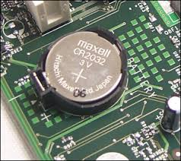
CMOS Battery
“Complementary Metal Oxide Semi-Conductor” is abbreviated as CMOS. It is a battery or cell which is featured with 3.0 Volts lithium type cell. The work of CMOS Battery is – it helps to store or keep the information in the BIOS mode.

Slide 66
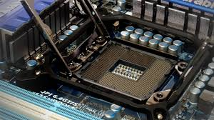
CPU Socket
CPU socket helps to install the processor into the Motherboard. On the bottom of the motherboard, the socket carries hundreds of metal connectors for the metal pins or balls.

Slide 67
TYPES OF CPU SOCKETS
i) Socket7:
ii) Socket370:
iii) Socket 775:
iv) Socket 1156:
v) Socket 1366:

Slide 68
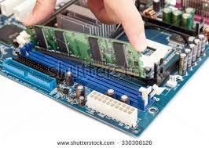
RAM (Memory) Slots
For installing RAM modules, a motherboard may have more than one slots, and it is positioned near the CPU socket. In general, RAM is most needed parts of the motherboard and it refers to Random Access Memory.

Slide 69
TYPES OF RAM SLOTS
SIMM slot
DIMM slot
RIMM slot

Slide 70
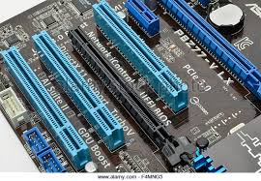
Expansion Card Slots
When we need to add new components to the motherboard or we want to update any parts of the motherboard, a motherboard’s expansion card slots allow us do that.

Slide 71
TYPES OF Expansion Card Slots
ISA slots
PCI Slots
PCI Express
AGP slot

Slide 72
ISA slots. These were the oldest expansion slots in the history of motherboards. They were found in AT boards and are identified by black color. Conventional display cards or sound cards were installed in these slots. The full form of ISA is Industry Standard Architecture and is a 16- bit bus.
PCI Slots. The full form of PCI is Peripheral Component Interconnect. The PCI slot is one of the important motherboard components today and is vastly used to install add-on cards on the motherboard. The PCI supports 64-bit high-speed bus.

Slide 73
PCI express. Also known as PCI e, these are the latest and the fastest component of the motherboard to support add-on cards. It supports full duplex serial bus.
AGP slot. Accelerated graphics port(AGP) is specifically used to install a latest graphics card. AGP runs on a 32-bit bus and both PCI e and AGP can be used to install high-end gaming display cards.

Slide 74
Peripheral components ports
Serial
Parallel
USB
Video Connectors

Slide 75
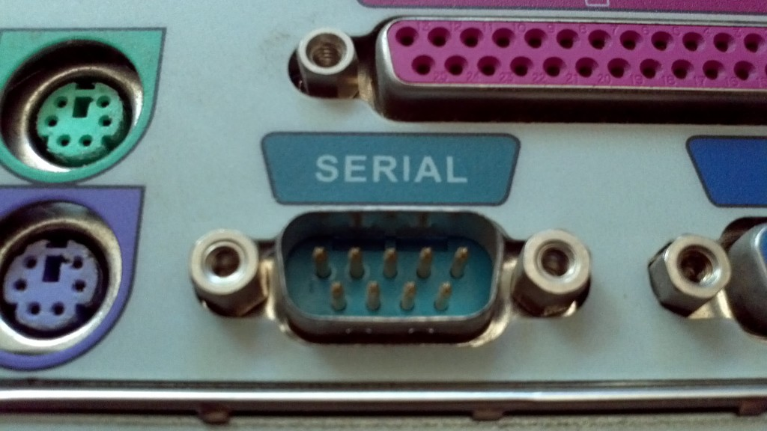
Serial Port
A serial port is an interface that allows a PC to transmit or receive data one bit at a time.
It is one of the oldest types of interfaces and at one time was commonly used to connect printers and external modems to a PC.

Slide 76

Parallel Port
A parallel port is an interface allowing a personal computer (PC) to transmit or receive data down multiple bundled cables to a peripheral device such as a printer.
A parallel port has multiple connectors and in theory allows data to be sent simultaneously down several cables at once.
This technology is still used today for low-data-rate communications such as dot-matrix printing.

Slide 77
USB:
Short for Universal Serial Bus, an external bus standard that supports data transfer rates of 12 Mbps. A single USB port can be used to connect up to 127 peripheral devices, such as mice, modems, and keyboards. USB also supports Plug-and-Play installation and hot plugging.

Slide 78
Types of Bus
Inside computers, there are many internal components. In order for these components to communicate with each other they make use of wires that are known as a ‘bus’
A bus is a common pathway through which information flows from one computer component to another.
This pathway is used for communication purpose and it is established between two or more computer components.

Slide 79


Slide 80
Bus Architecture
Control Bus:
A control bus is a computer bus that is used by the CPU to communicate with devices that are contained within the computer.
The control bus is bidirectional and assists the CPU in synchronizing control signals to internal devices and external components.
It is comprised of interrupt lines, byte enable lines, read/write signals and status lines.

Slide 81
Data Bus:
A data bus is a system within a computer or device, consisting of a connector or set of wires, that provides transportation for data.
A data bus can transfer data to and from the memory of a computer, or into or out of the central processing unit (CPU) that acts as the device's "engine." A data bus can also transfer information between two computers.

Slide 82
Address Bus:
A data bus can transfer data to and from the memory of a computer, or into or out of the central processing unit (CPU) that acts as the device's "engine." A data bus can also transfer information between two computers.

Slide 83

Storage Device Connectors
A computer needs some other types of storage devices to store the data or performing efficiently including hard drives, optical drives, and floppy drives.

Slide 84
Power Connectors
A Motherboard needs the power to keep running and it gets the power from SMPS. There are connectors to keep the process going on.
i) AT connector: It is one of the connectors which is found on the oldest motherboard and it has 2 number of 6 pin male connectors to make the supplying process.
ii) ATX connector: These types of the connector is found on the latest forms of the motherboard. It consists 20 or 24 pin female connectors and it is considered as the latest power connectors.

Slide 85

IDE connector
IDE is the short form of “Integrated Drive Electronics” and it is used to connect the disk drives including floppy disk drives and HDD (Hard Disk Drives). Here you will find 40-pin male connector that connects HDD. At the same time, the 34-pin male connector that connects the FDD.

Slide 86

SATA connector
SATA is the abbreviation of “Serial Advanced Technology Attachment.” Important to realize, it is the latest connectors with 7-pin interface. It is used to connect the SATA hard disks or optical drives. It is faster and better than the IDE Connector.

Slide 87
Co-Processor
One of vital parts or components of the motherboard is Co-Processors. It is used to perform mathematical calculations and computer graphics with the main processors.

Slide 88
Cabinet connections
It is the place where the motherboard is installed. It contains many buttons to connect the cabinet with the motherboard. Mostly used cabinet connectors are Power Switch, Reset Switch, Front USB, Front Audio, Power indicator(LED) and HDD LED.

Slide 89
Some other parts/Components of Motherboard and their Functions:

Slide 90
Chipset-North Bridge (CNB)
It is an integrated circuit with two chipsets and performs some particular task.

Slide 91
Firewire header (IEEE 1394)
It is the serial bus which is used to transfer digital and audio data.

Slide 92

PS/2 Connectors
It is the very common connects and all the motherboard contains two of it’s for connecting the keyboard and mouse.

Slide 93
USB (Universal Serial Bus) Port:
USB port is located on every motherboard for connecting external devices or storages including pen drive or audio jack.

Slide 94

Parallel or (LPT) Port
The port helps to connect the scanners and printers.

Slide 95

Game Port
The port is used to connect all the gaming devices, for example, a joystick.

Slide 96

Sound Card Connectors
For connecting audio devices including speakers or headphone this sound card connectors are used.

Slide 97
Display Connector
It helps to connect the monitor to the motherboard.

Slide 98
COM (Communication) Port
This device has been built to connect different devices including mouse, modem.

Slide 99
What is SMPS?
SMPS or switched mode power supply is an electronics device that is used to convert AC to DC, AC to AC, DC to DC and DC to AC voltages.
The SMPS used in computers is of AC to DC type supply.

Slide 100

Power Connectors
In order to receive power from SMPS, there are connectors mounted on the motherboards.
AT connector. It consists of 2 number of 6 pin male connectors and is found on old types of motherboards.
ATX connector. The latest in the series of power connectors, they are either 20 or 24 pin female connectors. Found in all the latest types of motherboards.

Slide 101
Earthing
If there is a fault in your electrical installation you could get an electric shock if you touch a live metal part.
This is because the electricity may use your body as a path from the live part to the earth part.
Earthing is used to protect you from an electric shock.

Slide 102

How to test computer SMPS?

Slide 103

HARD DISK
Hard Disk of our computer store our data and also store the operating system of any computer.

Slide 104
Key Components of a Hard Drive
Platter
Read-Write Heads
Actuator
Spindle
PCB (Printed Circuit Board)

Slide 105

CD- ROM
A CD-ROM is a optical compact disc which contains data. The acronym which stands for "Compact Disc- Read Only Memory". Computers can read CD-ROMs, but cannot write to CD-ROMs, which are not writable or erasable.

Slide 106

Magnetic Tapes
Magnetic tape is a medium for magnetic recording, made of a thin, magnetizable coating on a long, narrow strip of plastic film.

